Slide 1
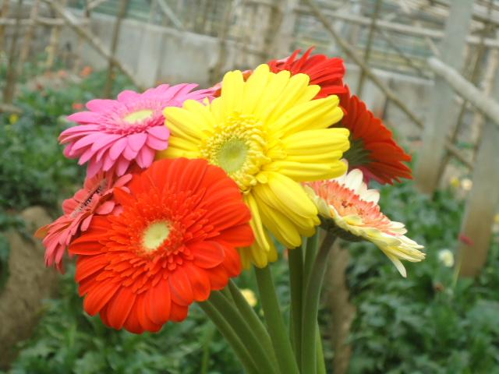
welcome

Slide 2
PRESENTED BY
NAZMUN NAHAR
Assistant teacher
Horinarayanpur Govt. primary School
Sadar, Noakhali .

Slide 3
Class: one
Lesson: A -H
Title: A –D ( a- d )
Time -40 minutes

Slide 4
Now see the video

Slide 5
Learning outcomes
Student will be able to
Identify Capital and Small letters A B C D (a b c d ).

Slide 6
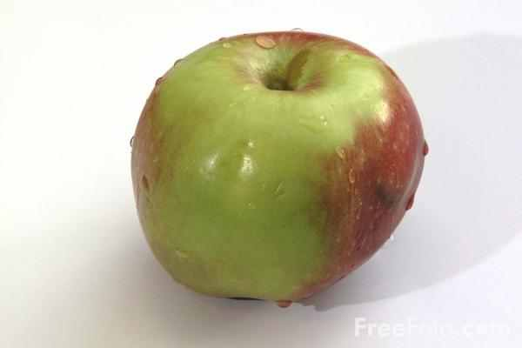
A a
Apple

Slide 7

B b
Ball

Slide 8
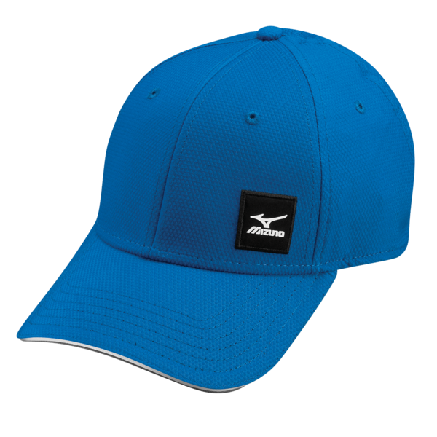
C c
Cap

Slide 9
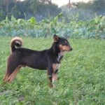
D d
Dog

Slide 10
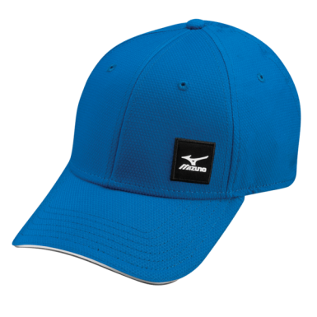

Matching
Apple
Ball
Cap
Dog

Slide 11
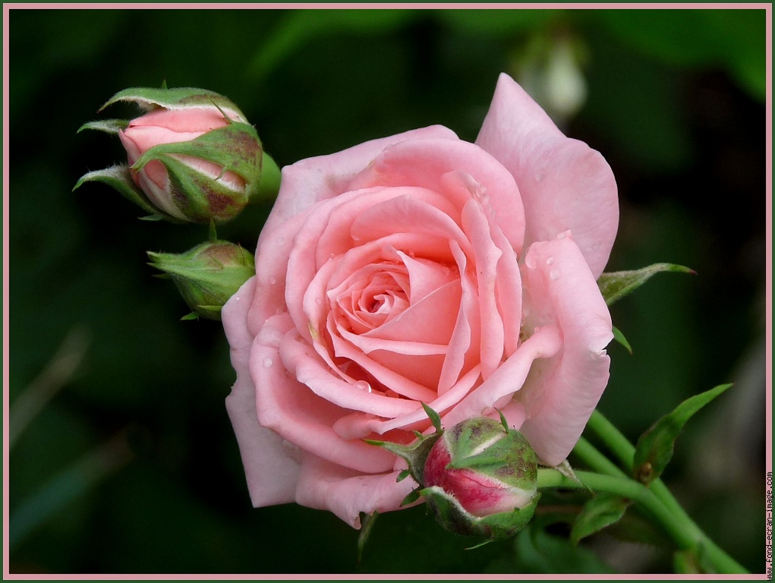
THANKS

